Slide 1

Secure Autonomous CPS Through Verifiable Information Flow Control
Jed Liu | Joe Corbett-Davies | Andrew Ferraiuolo | Alexander Ivanov
Mulong Luo | G. Edward Suh | Andrew C. Myers | Mark Campbell
4th ACM Workshop on Cyber-Physical Systems Security and Privacy 19 October 2018

Slide 2
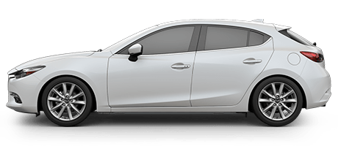
Networked CPSes are everywhere!

Slide 3
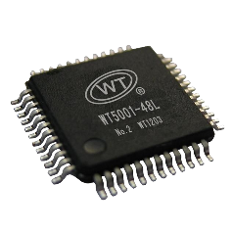
Networked CPSes are everywhere!
Internet

Slide 4
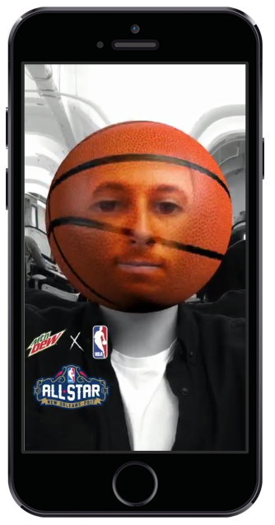
Networked CPSes are everywhere!
Internet

Slide 5
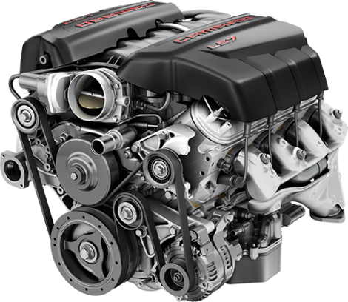
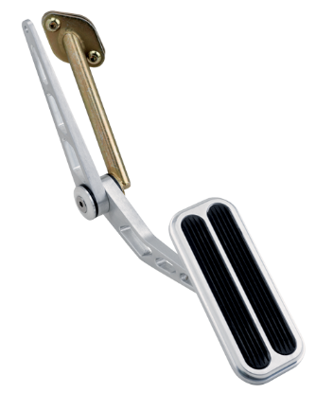
Networked CPSes are everywhere!
Internet

Slide 6
Networked CPSes are everywhere!
Internet

Slide 7
A new approach
General architecture for secure CPS
Co-develop hardware, software, control algorithms
Security designed into all levels of system
Leverage information-flow control
Security-typed languages for software & hardware

Slide 8
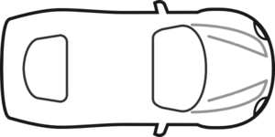
System model (autonomous vehicle)
Vehicle hardware

Slide 9

System model (autonomous vehicle)
Safety-critical
software
Untrusted
software
Vehicle hardware

Slide 10
System model (autonomous vehicle)
Safety-critical
software
Makes control decisions
e.g., planning, perception
Untrusted
software
Vehicle hardware

Slide 11
System model (autonomous vehicle)
Safety-critical
software
Makes control decisions
e.g., planning, perception
Untrusted
software
Everything else
e.g., entertainment
Vehicle hardware

Slide 12
System model (autonomous vehicle)
Assumption: vehicle is a single monolithic hardware device
Simplifies model
Security more difficult
Hardware isolation fails in practice
Jeep attack [MV’15]
Safety-critical
software
Untrusted
software
Vehicle hardware

Slide 13
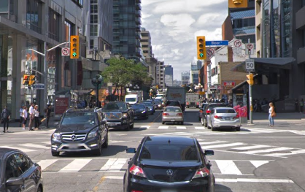
System model (autonomous vehicle)
Sensors
GPS, Radar, Lidar, vision, etc.
Safety-critical
software
Environment
Untrusted
software
Network
maps, traffic, music, etc.
Internet
Vehicle hardware

Slide 14

Adversary model
Security goal Defend safety-critical software from remote adversary
Sensors
GPS, Radar, Lidar, vision, etc.
Safety-critical
software
Environment
Untrusted
software
Network
maps, traffic, music, etc.
Internet
Vehicle hardware

Slide 15
Adversary model
Security goal Defend safety-critical software from remote adversary
Adversary
Can manipulate some sensors & network inputs
Sensors
GPS, Radar, Lidar, vision, etc.
Safety-critical
software
Environment
Untrusted
software
Network
maps, traffic, music, etc.
Internet
Vehicle hardware

Slide 16
Adversary model
Security goal Defend safety-critical software from remote adversary
Adversary
Can manipulate some sensors & network inputs
Controls all untrusted software
Sensors
GPS, Radar, Lidar, vision, etc.
Safety-critical
software
Environment
Untrusted
software
Network
maps, traffic, music, etc.
Internet
Vehicle hardware

Slide 17
Threats
Manipulate sensors & network inputs
Control untrusted software

Slide 18

Threats
Manipulate sensors & network inputs
Control untrusted software
Attacks on control algorithms & implementation
Attacks on underlying OS & hardware

Slide 19
Threats
Manipulate sensors & network inputs
Provide bad maps, spoof sensors, tamper w/ env.
Control untrusted software

Slide 20
Threats
Manipulate sensors & network inputs
Provide bad maps, spoof sensors, tamper w/ env.
Exploit vulnerabilities in software implementation
memory safety bugs, inappropriate use of unverified inputs
Control untrusted software

Slide 21
Threats
Manipulate sensors & network inputs
Provide bad maps, spoof sensors, tamper w/ env.
Exploit vulnerabilities in software implementation
memory safety bugs, inappropriate use of unverified inputs
Control untrusted software
Exploit OS bugs to break software isolation
Exploit hardware:
Bugs that break software isolation
Hardware-level timing interference slows down safety-critical software
Order of magnitude difference! [MM’07]

Slide 22
General architecture for secure autonomous CPS
Security integrated into full system stack
Policies at language level, pushed into hardware

Slide 23
General architecture for secure autonomous CPS
Security integrated into full system stack
Policies at language level, pushed into hardware
Security-typed languages to design hardware & software

Slide 24
General architecture for secure autonomous CPS
Internet
Environment
raw sensors & inputs
Untrusted software

Slide 25
General architecture for secure autonomous CPS
Internet
Environment
raw sensors & inputs
Untrusted software
Verification
labelled sensors & inputs
Design system w/ redundant inputs
Verify each input against the others
Highly consistent inputs → highly trusted

Slide 26
Threats
Manipulate sensors & network inputs
Provide bad maps, spoof sensors, tamper w/ env.
Exploit vulnerabilities in software implementation
memory safety bugs, inappropriate use of unverified inputs
Control untrusted software
Exploit OS bugs to break software isolation
Exploit hardware:
Bugs that break software isolation
Hardware-level timing interference slows down safety-critical software

Slide 27
Threats
Manipulate sensors & network inputs
Provide bad maps, spoof sensors, tamper w/ env.
Exploit vulnerabilities in software implementation
memory safety bugs, inappropriate use of unverified inputs
Control untrusted software
Exploit OS bugs to break software isolation
Exploit hardware:
Bugs that break software isolation
Hardware-level timing interference slows down safety-critical software

Slide 28
General architecture for secure autonomous CPS
Internet
Environment
raw sensors & inputs
Verification
Perception
&
Planning
Untrusted software
labelled sensors & inputs
Vehicle controls

Slide 29
General architecture for secure autonomous CPS
Internet
Environment
raw sensors & inputs
Programmed in Jif [POPL’99]
Verification
Perception
&
Planning
Untrusted software
labelled sensors & inputs
Vehicle controls

Slide 30
General architecture for secure autonomous CPS
Quick primer on Jif
Java-based
Memory safety
Internet
Environment
raw sensors & inputs
Programmed in Jif [POPL’99]
Verification
Perception
&
Planning
Untrusted software
labelled sensors & inputs
Vehicle controls

Slide 31
General architecture for secure autonomous CPS
Quick primer on Jif
Java-based
Memory safety
Enforces information-flow security
Labels part of types
Internet
Environment
raw sensors & inputs
Programmed in Jif [POPL’99]
Verification
Perception
&
Planning
Untrusted software
labelled sensors & inputs
Vehicle controls

Slide 32
General architecture for secure autonomous CPS
Quick primer on Jif
Java-based
Memory safety
Enforces information-flow security
Labels part of types
Internet
Environment
raw sensors & inputs
Programmed in Jif [POPL’99]
00100000
00100110
11100111
11101010
00100000
00100110
11100111
11101010
Verification
Perception
&
Planning
Untrusted software
labelled sensors & inputs
Vehicle controls
T
U

Slide 33
General architecture for secure autonomous CPS
Quick primer on Jif
Java-based
Memory safety
Enforces information-flow security
Labels part of types
Internet
Environment
raw sensors & inputs
Programmed in Jif [POPL’99]
00100000
00100110
11100111
11101010
00100000
00100110
11100111
11101010
Verification
Perception
&
Planning
Untrusted software
labelled sensors & inputs
Vehicle controls
T
⊑
U
“flows to”

Slide 34
General architecture for secure autonomous CPS
Quick primer on Jif
Java-based
Memory safety
Enforces information-flow security
Labels part of types
Downgrading via endorse
Internet
Environment
raw sensors & inputs
Programmed in Jif [POPL’99]
00100000
00100110
11100111
11101010
00100000
00100110
11100111
11101010
Verification
Perception
&
Planning
Untrusted software
labelled sensors & inputs
Vehicle controls
T
⊑
U
“flows to”

Slide 35
Threats
Manipulate sensors & network inputs
Provide bad maps, spoof sensors, tamper w/ env.
Exploit vulnerabilities in software implementation
memory safety bugs, inappropriate use of unverified inputs
Control untrusted software
Exploit OS bugs to break software isolation
Exploit hardware:
Bugs that break software isolation
Hardware-level timing interference slows down safety-critical software

Slide 36
General architecture for secure autonomous CPS
Internet
Environment
raw sensors & inputs
Verification
Perception
&
Planning
Untrusted software
labelled sensors & inputs
Vehicle controls
Verified microkernel OS (e.g., seL4 [KEH⁺’09])

Slide 37
General architecture for secure autonomous CPS
Internet
Environment
raw sensors & inputs
Verification
Perception
&
Planning
Untrusted software
labelled sensors & inputs
Vehicle controls
Verified microkernel OS (e.g., seL4 [KEH⁺’09])
Processor with timing compartments
Verified w/ ChiselFlow security-typed HDL [CCS’18]
timing-sensitive information-flow security

Slide 38

Overview of HW timing isolation

Slide 39
Overview of HW timing isolation
Identify the security domain for each resource request
Timing compartment: security domain for timing isolation
Allocate hardware resources to each timing compartment
Spatial partitioning for stateful resources
e.g., memory, caches, TLB, BHT, BTB
Temporal partitioning for stateless resources
e.g., I/O ports, interconnect, memory channels

Slide 40
Hardware security tags
Core 1
Core 2
Crypto
Engine
tag
tag
RF
tag
RF
tag
tag
DMA
tag
L1
L1
On-Chip Interconnect
tag
L2 cache
I/O
tag
tag
Memory Controller
DRAM
Peripheral
tag
Information-flow security enforced w/ explicit hardware tags
Tag for each core, register, memory page, etc.
Each cache/memory access tagged
Similar to Jif labels

Slide 41
Spatial partitioning
Removes timing interference through stateful elements
Caches, buffers, etc.
Allocate state to each timing compartment
Flush state to prevent vulnerabilities when allocation changes
Core
Core
Core
Core
L1/2
L1/2
L1/2
L1/2
L3 access comes
with a TCID
L3 Cache
L3 Cache

Slide 42
Temporal partitioning
Removes timing interference through resource contention
e.g., I/O ports, on-chip interconnects, DRAM channels
Timing compartments take turns accessing the resource
Time-division multiplexing
Turn
TC 0
TC 1
TC N
DRAM Time Slots
Time

Slide 43
General architecture for secure autonomous CPS
Internet
Programmed in Jif [POPL’99]:
memory safety
information-flow security
Environment
raw sensors & inputs
Verification
Perception
&
Planning
Untrusted software
labelled sensors & inputs
Vehicle controls
Verified microkernel OS (e.g., seL4 [KEH⁺’09])
Processor with timing compartments
Verified w/ ChiselFlow security-typed HDL [CCS’18]
timing-sensitive information-flow security

Slide 44
Two prototypes
Secure processor: HyperFlow [CCS’18]
Extends single-core RISC-V Rocket processor
Full timing-channel protection
Checked w/ security type system in ChiselFlow
Segway robot software
Verifier & planner for lane following
Working on Jif compiler for RISC-V

Slide 45
Two prototypes
Secure processor: HyperFlow [CCS’18]
Extends single-core RISC-V Rocket processor
Full timing-channel protection
Checked w/ security type system in ChiselFlow
Segway robot software
Verifier & planner for lane following
Jif compiler for RISC-V under development

Slide 46
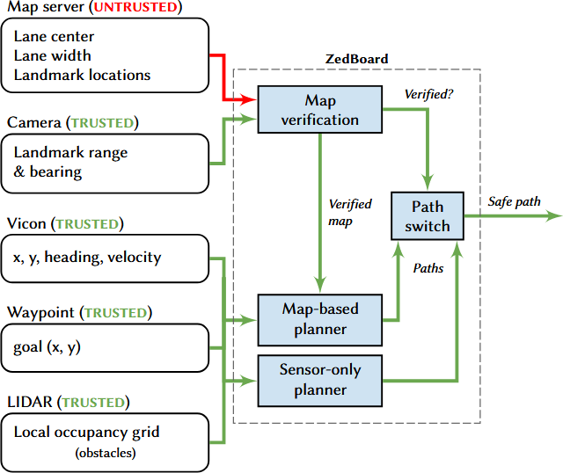
Software prototype

Slide 47
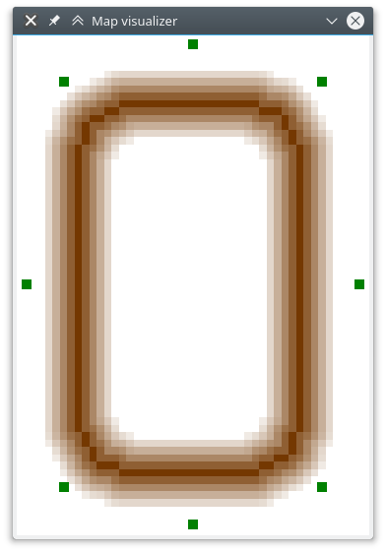
Map data
Expected landmark location
Verified against landmarks in environment
Used ArUco tags to simplify sensor processing
Ground truth lane centre
(shown for reference)
Lane reward function

Slide 48
Software implementation
Map verifier & A*-based planner—630 lines of Jif
1,000 lines of Java code for network communication
class Map[T,U] where T ⊑ U {
Grid{U} unverif;
Grid{T} verif;
}
void verify(map, sensor) {
if (canVerify(map, sensor))
map.verif =
endorse(map.unverif);
else map.verif = null;
}
Plan{T} plan(start, goal, map) {
// If map unverified, use contingency.
Grid grid = map.verif;
if (grid == null)
return contingency(start, goal);
// Do A*.
return astar(start, goal, grid);
}

Slide 49
Software implementation
Map verifier & A*-based planner—630 lines of Jif
1,000 lines of Java code for network communication
class Map[T,U] where T ⊑ U {
Grid{U} unverif;
Grid{T} verif;
}
void verify(map, sensor) {
if (canVerify(map, sensor))
map.verif =
endorse(map.unverif);
else map.verif = null;
}
Plan{T} plan(start, goal, map) {
// If map unverified, use contingency.
Grid grid = map.verif;
if (grid == null)
return contingency(start, goal);
// Do A*.
return astar(start, goal, grid);
}

Slide 50
Software implementation
Map verifier & A*-based planner—630 lines of Jif
1,000 lines of Java code for network communication
class Map[T,U] where T ⊑ U {
Grid{U} unverif;
Grid{T} verif;
}
void verify(map, sensor) {
if (canVerify(map, sensor))
map.verif =
endorse(map.unverif);
else map.verif = null;
}
Plan{T} plan(start, goal, map) {
// If map unverified, use contingency.
Grid grid = map.verif;
if (grid == null)
return contingency(start, goal);
// Do A*.
return astar(start, goal, grid);
}

Slide 51
Software implementation
Map verifier & A*-based planner—630 lines of Jif
1,000 lines of Java code for network communication
class Map[T,U] where T ⊑ U {
Grid{U} unverif;
Grid{T} verif;
}
void verify(map, sensor) {
if (canVerify(map, sensor))
map.verif =
endorse(map.unverif);
else map.verif = null;
}
Plan{T} plan(start, goal, map) {
// If map unverified, use contingency.
Grid grid = map.verif;
if (grid == null)
return contingency(start, goal);
// Do A*.
return astar(start, goal, grid);
}

Slide 52
Software implementation
Map verifier & A*-based planner—630 lines of Jif
1,000 lines of Java code for network communication
class Map[T,U] where T ⊑ U {
Grid{U} unverif;
Grid{T} verif;
}
void verify(map, sensor) {
if (canVerify(map, sensor))
map.verif =
endorse(map.unverif);
else map.verif = null;
}
Plan{T} plan(start, goal, map) {
// If map unverified, use contingency.
Grid grid = map.verif;
if (grid == null)
return contingency(start, goal);
// Do A*.
return astar(start, goal, grid);
}

Slide 53
Software implementation
Map verifier & A*-based planner—630 lines of Jif
1,000 lines of Java code for network communication
class Map[T,U] where T ⊑ U {
Grid{U} unverif;
Grid{T} verif;
}
void verify(map, sensor) {
if (canVerify(map, sensor))
map.verif =
endorse(map.unverif);
else map.verif = null;
}
Plan{T} plan(start, goal, map) {
// If map unverified, use contingency.
Grid grid = map.verif;
if (grid == null)
return contingency(start, goal);
// Do A*.
return astar(start, goal, grid);
}

Slide 54
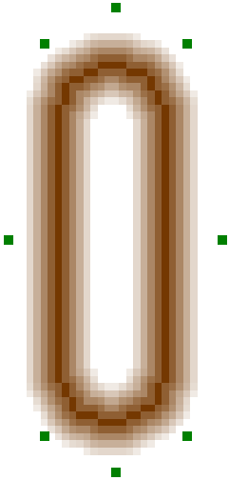
Evaluation: input validation
Landmark measurement
Robot position
Malicious map

Slide 55

Demo

Slide 56
Related work
Attack modalities
Conventional vehicles (Checkoway⁺ 2011)
Iran RQ-170 incident 2014
Control-algorithm security
Signal cross-validation (Pajic⁺ 2017)
Anomaly detection (Tian⁺ 2010, Xie⁺ 2011)
Formal methods
Quant. info flow for CPS (Morris⁺ 2017)
ROSCoq
Timing verification w/ SpaceEx (Ziegenbein⁺ 2015)
Secure HDL
Caisson (2011), Sapper (2014), SecVerilog (2015)
Secure processors
Tiwari⁺ 2011, Ferraiuolo⁺ 2017
Secure CPS integration
Veriphy (2018)
Restart-based security (Abad⁺ 2016, Abdi⁺ 2017, Arroyo⁺ 2017)
Our contribution: a new system architecture
Verified hardware
Language-based information flow in software
Cross-sensor input verification

Slide 57
Secure Autonomous CPS Through Verifiable Information Flow Control
Jed Liu | Joe Corbett-Davies | Andrew Ferraiuolo | Alexander Ivanov
Mulong Luo | G. Edward Suh | Andrew C. Myers | Mark Campbell
Programmed in Jif
memory safety
information-flow security
raw sensors & inputs
Verification
Perception
&
Planning
Untrusted software
labelled sensors & inputs
Vehicle controls
Verified microkernel OS
Verified processor with timing compartments

