Slide 1


Defining and Enforcing Referential Security
 | Jed Liu | Andrew C. Myers
3rd Conference on Principles of Security and Trust 7 April 2014

Slide 2
Referential security
Distributed systems span multiple trust domains
Natural to have cross-domain references
e.g., hyperlinks (web), foreign keys (DBs), CORBA, RMI, JPA+JTA, Fabric

Slide 3
Referential security
Distributed systems span multiple trust domains
Natural to have cross-domain references
e.g., hyperlinks (web), foreign keys (DBs), CORBA, RMI, JPA+JTA, Fabric
Problem: references introduce dependencies
Can create security & reliability vulnerabilities
New class of referential security vulnerabilities
First step towards programming model for writing code without these vulnerabilities

Slide 4
Referential security
Distributed systems span multiple trust domains
Natural to have cross-domain references
e.g., hyperlinks (web), JPA+JTA (distributed DBs)
Problem: references introduce dependencies
Can create security & reliability vulnerabilities
Contributions
Formalized three referential security goals
Static analysis (type system) to enforce them
Soundness proof

Slide 5


Directory example
alice
A
bob
B
docs
photos
docs
photos
Lyon

Slide 6
Referential integrity
alice
A
bob
B
docs
photos
docs
?
Referential security goals
Ensure referential integrity

Slide 7
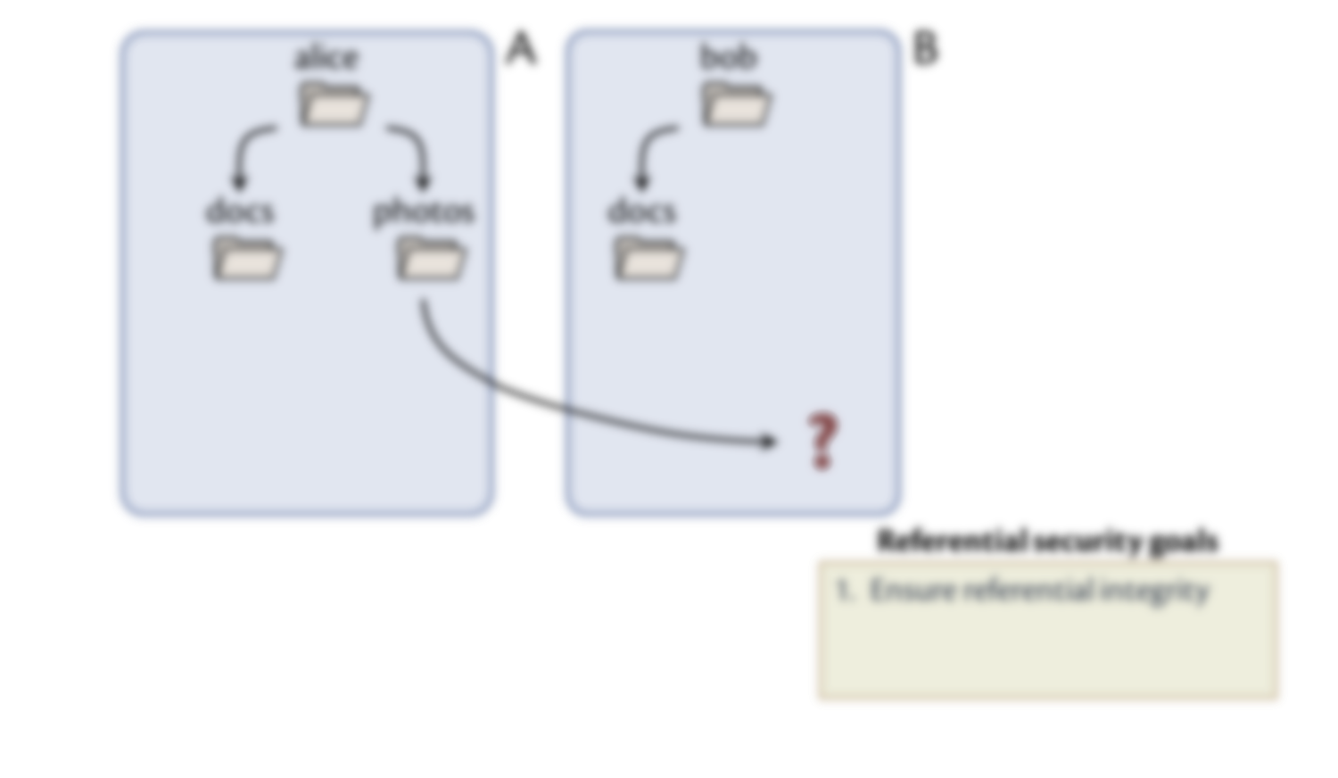
Referential integrity
Known to be important (e.g., Java, databases)
Not universal (e.g., web “404” errors)
A double-edged sword
Enforcing referential integrity creates other security vulnerabilities

Slide 8

Accidental persistence
alice
A
docs
photos
1GB
1GB
summary
1GB
1GB
Referential security goals
Ensure referential integrity
Prevent accidental persistence

Slide 9
Storage attacks
alice
A
docs
photos
1GB
1GB
1GB
1GB
Referential security goals
Ensure referential integrity
Prevent accidental persistence
Prevent storage attacks

Slide 10
A framework for referential security
Static analysis for enforcing referential security:
Presented as type system of λ_{persist} language
λ_{persist} extends λ→ with:
objects (mutable records)
references (immutable references to records)
Ensure referential integrity
Prevent accidental persistence
Prevent storage attacks

Slide 11
Preventing accidental persistence
Persist by policy, not by reachability
Each object has a persistence policy p
Ensure referential integrity
Prevent accidental persistence
Prevent storage attacks
persistent
policy
levels
transient

Slide 12
Preventing accidental persistence
Persist by policy, not by reachability
Each object has a persistence policy p
Node-set interpretation:
Who can delete object?
⊤ = ∅
policy
levels
{alice}
{bob}
⊥ = {alice,bob}
Ensure referential integrity
Prevent accidental persistence
Prevent storage attacks

Slide 13
Ensuring referential integrity
Type system ensures all persistence failures are handled
Factors out failure-handling code
try e₁ catch p: e₂
Who can delete object?
⊤ = ∅
policy
levels
{alice}
{bob}
⊥ = {alice,bob}
Ensure referential integrity
Prevent accidental persistence
Prevent storage attacks

Slide 14
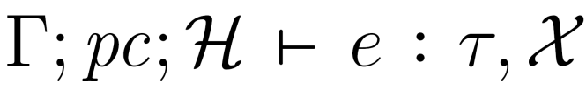
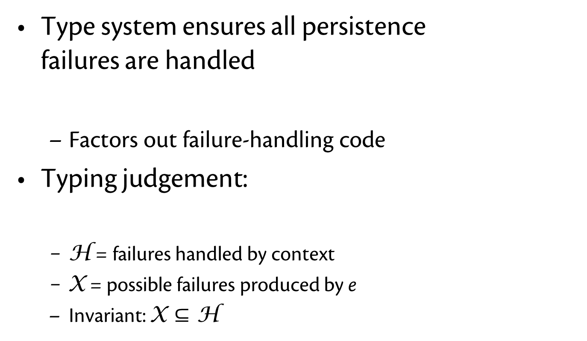
Ensuring referential integrity
Type system ensures all persistence failures are handled
Factors out failure-handling code
Typing judgement:
H = failures handled by context
X = possible failures produced by e
Invariant: X $⊆$ H
try e₁ catch p: e₂
Who can delete object?
⊤ = ∅
policy
levels
{alice}
{bob}
⊥ = {alice,bob}
Ensure referential integrity
Prevent accidental persistence
Prevent storage attacks

Slide 15
Directory example
alice
A
bob
B
docs
photos
docs
photos
Who can delete object?
⊤ = ∅
Lyon
policy
levels
{alice}
{bob}
p = {alice}
p = {bob}
⊥ = {alice,bob}
Programs must be ready to handle failure:
try Lyon.show () catch bob: …
Ensure referential integrity
Prevent accidental persistence
Prevent storage attacks

Slide 16
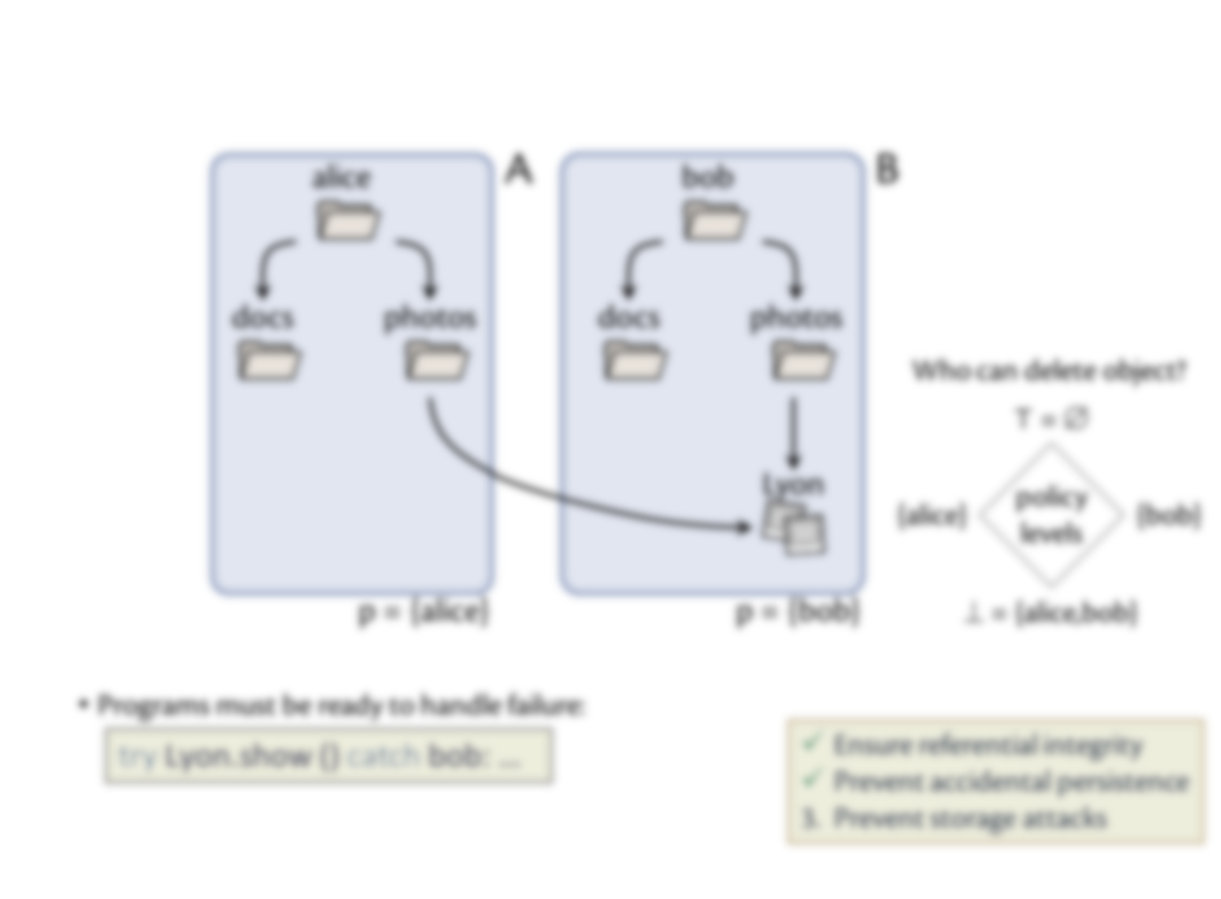
Directory example
Who is the adversary?
Alice? Bob? Someone else?

Slide 17
Modelling the adversary
Assume adversary controls some nodes in system
Adversary modelled as a point α on lattice
Cannot affect objects having policies at or above α
⊤ = ∅
Node-set interpretation:
α = set of nodes not controlled by adversary
{alice}
{bob}
α = {alice, bob}
Adversary cannot affect
{chuck}
{alice, chuck}
{bob, chuck}
Ensure referential integrity
Prevent accidental persistence
Prevent storage attacks
⊥ = {alice, bob, chuck}

Slide 18
Preventing storage attacks
Each object has a creation authority policy a
Authority policy for short
Restricts ability to create new refs
Taken from same lattice as persistence policies
no one can create ref
policy
levels
Ensure referential integrity
Prevent accidental persistence
Prevent storage attacks
anyone can create ref

Slide 19
Preventing storage attacks
Each object has a creation authority policy a
Authority policy for short
Restricts ability to create new refs
Taken from same lattice as persistence policies
Node-set interpretation:
Who can create reference?
⊤ = ∅
policy
levels
{alice}
{bob}
Ensure referential integrity
Prevent accidental persistence
Prevent storage attacks
⊥ = {alice,bob}

Slide 20
Preventing storage attacks
Each object has a creation authority policy a
Authority policy for short
Restricts ability to create new refs
Taken from same lattice as persistence policies
What if you don’t have authority?
(Hard) References have referential integrity, require authority
Soft references do not
Host-set interpretation:
Who can create reference?
⊤ = ∅
policy
levels
{alice}
{bob}
⊥ = {alice,bob}
Ensure referential integrity
Prevent accidental persistence
Prevent storage attacks

Slide 21
Example
alice
A
bob
B
a = {alice}
a = {bob}
Who can create reference?
docs
photos
docs
photos
⊤ = ∅
a = {alice}
a = {alice}
a = {bob}
a = {bob}
policy
levels
{alice}
{bob}
itinerary
Lyon
⊥ = {alice,bob}
a = {alice,bob}
a = {bob}
p = {alice}
p = {bob}
hard ref
soft ref

Slide 22
Integrity
Adversary controls some nodes
Can modify some objects affect program state
Can affect decision to create references
To enforce authority, type system tracks:
Integrity of values
Integrity of control flow
pc bounds authority of references created by e
if L then x.f = o

Slide 23
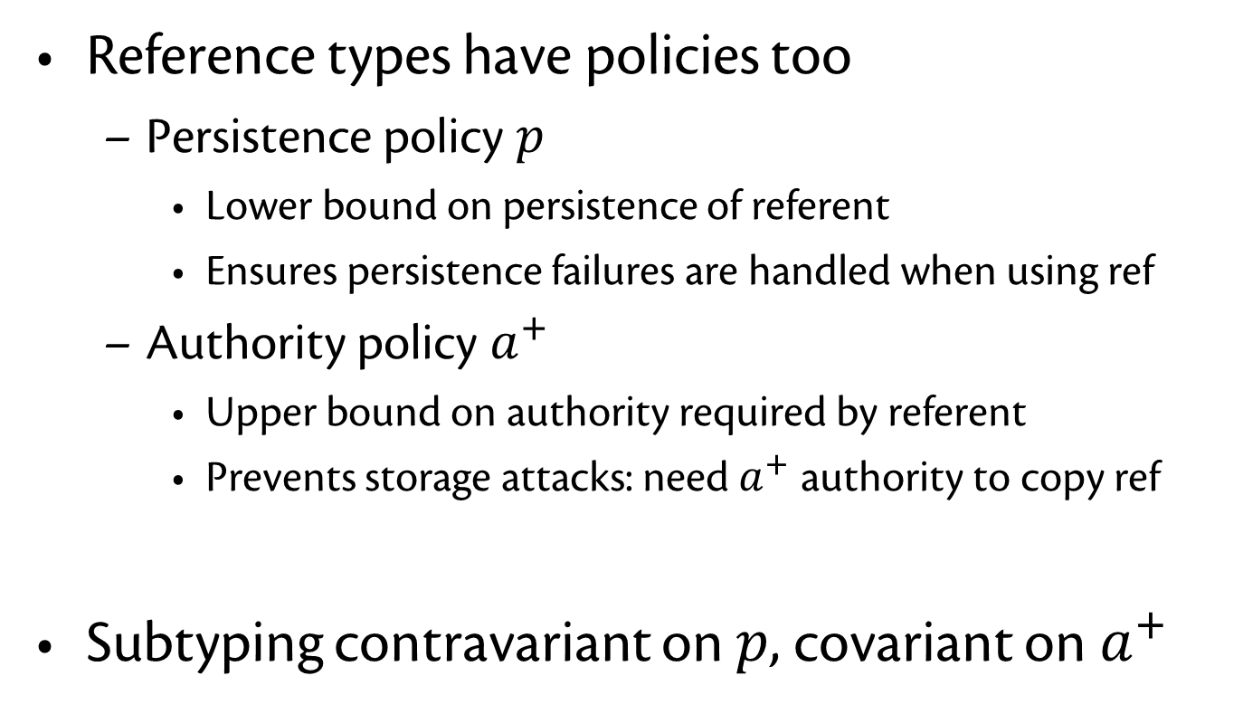
Policies on reference types
Reference types have policies too
Persistence policy $p$
Lower bound on persistence of referent
Ensures persistence failures are handled when using ref
Authority policy $a^{+}$
Upper bound on authority required by referent
Prevents storage attacks: need $a^{+}$ authority to copy ref
Subtyping contravariant on $p$, covariant on $a^{+}$

Slide 24
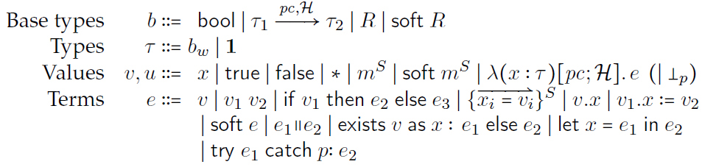
λ_{persist}
soft e – creates soft ref out of hard ref
exists v as x: e₁ else e₂
checks whether soft ref still valid (if yes, promotes to hard ref)
try e₁ catch p: e₂ – persistence-failure handler

Slide 25
λ_{persist}
Operational semantics
Machine configuration: <e, M>
Small step: <e₁, M₁> → <e₂, M₂>
Includes model of garbage collector
partially evaluated program
program memory
maps typed locations m^{S} to records or to ⊥ if deleted

Slide 26
Power of the adversary
Between program steps, adversary can arbitrarily:
Create new objects
Objects must have low integrity & low persistence
Assign into low-integrity fields
Delete low-persistence objects
Matches assumption: adversary has total control over its nodes

Slide 27
Proving referential security
Idea: execution with adversary should be “equivalent” to execution without adversary
But memory locations may not match up
Relate traces using homomorphism φ on typed locations
with adversary
φ
without adversary
Properties of φ
Partial
Injective
Type-preserving
Isomorphic when restricted to:
high-integrity locations
high-persistence locations
– high-integrity locations
– high-persistence locations

Slide 28

Security relation
For expressions: $e_{1}≈_{α}^{φ}e_{2}$
Expressions are equivalent when locations are transformed by φ

Slide 29

Security relation
For expressions: $e_{1}≈_{α}^{φ}e_{2}$
Expressions are equivalent when locations are transformed by φ
For memories: $M_{1}≈_{α}^{φ}M_{2}$
with adversary
without adversary
m₁
φ(m₁) φ( )
where m₁ is mapped by φ
m₂
φ(m₂)
where m₂ is high-authority and high-persistence

Slide 30
Referential security
Theorem: Security relation is preserved by computation
(assuming e_{i} well-typed and certain well-formedness conditions)
Lemma: Adversary cannot cause more high-authority locations to become non-collectible
<e₁, M₁>
<e’₁, M’₁>
α
with adversary
≈
≈
without adversary
φ,α
φ’,α
<e₂, M₂>
*
<e’₂, M’₂>

Slide 31
Related work
System mechanisms (orthogonal to lang. model)
e.g., improving referential integrity of hyperlinks
Liblit & Aiken
Type system for distributed data structs (no security)
Riely & Hennessey
Type safety in distributed system w/ partial trust
Chugh et al.
Dynamically loading untrusted JavaScript
Information flow: non-interference

Slide 32
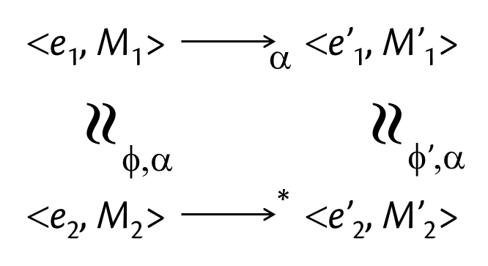
Defining and Enforcing Referential Security
Jed Liu | Andrew C. Myers
λ_{persist}
Referential security goals
Ensure referential integrity
Prevent accidental persistence
Prevent storage attacks

